Slide 1
Welcome to CS 211

Slide 2
Course Websites
Canvas (now at canvas.Humboldt.edu) is the central hub for the course
Github (https://github.com/acarteas/Teaching-DataStructures/) will be used to store all course materials: course syllabus, official calendar, assignment descriptions, and other course documents

Slide 3
The required textbook is free!
Data Structures and Algorithm Analysis v3.2 by Clifford Shaffer
Find the book on course Github
Also available from the author at https://people.cs.vt.edu/shaffer/Book/C++3elatest.pdf

Slide 4

Other Recommended Reading

Slide 5
I will be periodically asking "clicker" questions in the course (including today!)
Turning point subscription not required

Slide 6
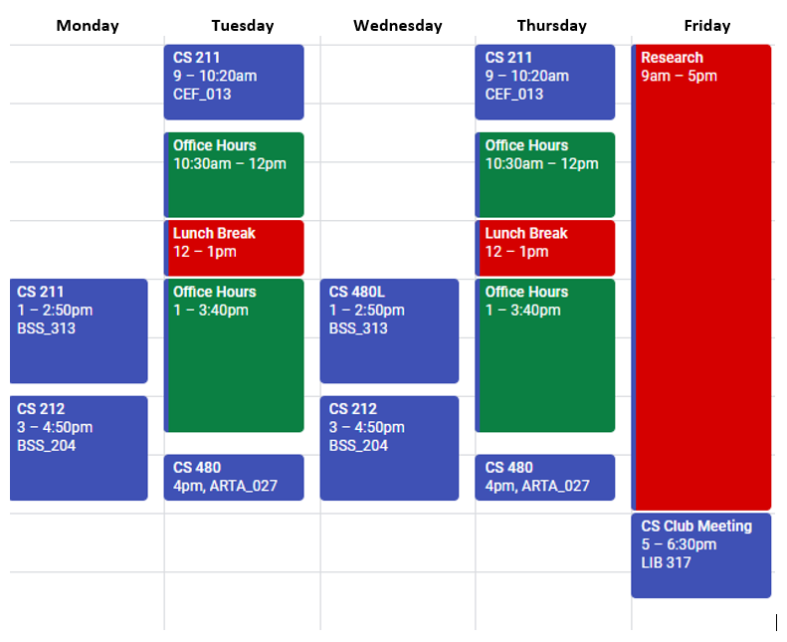
Adam’s Schedule

Slide 7
Grading
I’m continuing my “progressive” grading scheme from last semester
Idea: I care more about what you know at the end of the semester than what you know at the beginning of the semester
Possible solution: Through permissive grading, make it easier to get good grades at the beginning of the semester
Example: In order to get an A on PA1, you only need to get 70 out of 100 points possible.
On the final PA, you will actually need to earn 90+ points to get an A
Notes:
My hope is that this system will also allow me to push you while simultaneously allowing you to fail gracefully.

Slide 8
Programming Environments
I encourage you to use an IDE when working on your solutions. My preference for IDEs are:
Visual Studio 2017 (community edition is free for everyone; enterprise is free for HSU CS Majors!)
JetBrains CLion
Netbeans 8.1 (Be sure you're in C++ 11 or C++ 14 mode!)
CodeBlocks (Be sure you're in C++ 11 or C++ 14 mode!)
I prefer VS 2017 because it has the best and easiest to use debugging capabilities.

Slide 9
Homework Policy
All homework must be submitted by the due date
No "late" turn-ins
"Late" is somewhat floating
"Late" means the time after whenever I pull your code from canvas
Thus, 12:01 AM is not considered late
I usually pull code mid morning after a due date (e.g. around 10AM), but sometimes I forget to pull the code until much later.
Takeaway: Try to have the code in by the true deadline, but if it's a few hours late you're probably fine.

Slide 10
A Note on Cheating
Don't do it!
See syllabus for examples of cheating.
I usually catch at least one cheater per semester. Don’t let this be you!

Slide 11
Grade breakdown
Participation (3%)
!!GitHub usage (5%)!!
Programming assignments, homework, and micro assignments (39%)
Labs (10%)
Two midterm exams (9% / ea)
Final exam (25%)

Slide 12
Final grade translations
93.00 – 100.00 | A | 71.00 – 75.99 | C
90.00 – 92.99 | A- | 69.00 – 70.99 | C-
87.00 – 89.99 | B+
82.00 – 86.99 | B | 60.00 – 68.99 | D
78.00 – 81.99 | B- | 00.00 – 59.99 | F
76.00 – 77.99 | C+

Slide 13
GitHub demo

Slide 14
All course materials are posted on GitHub
You will almost always find the starter code for the lecture on GitHub several hours (if not the day before) the lecture.
I encourage you to download the code so you can more easily follow along.
I almost always post my final lecture code on GitHub immediately after class (unless I get distracted)
For those wanting to get a head start on homeworks and labs, I almost always post HW and lab descriptions a few days before I introduce them in class.
Note that I reserve the right to significantly change things until they are actually assigned.!

Slide 15
Today's review topics
Reading from and writing to files
Sending ifstream objects to functions
Reading from and writing to CSV files

